Slide 1

Decision Trees & Random Forests
Data Science Curriculum

Slide 2
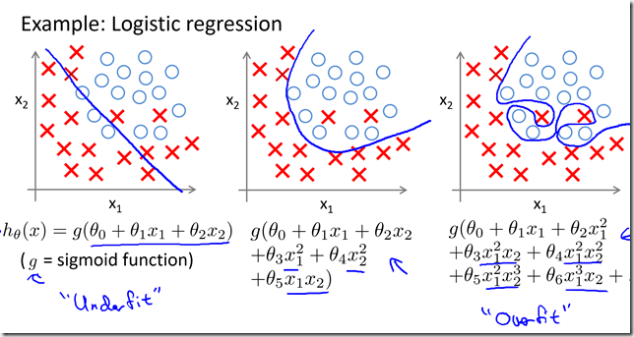
Last week we learnt..
3x Lessons - Logistic Regression for Classification tasks
Classifies 2 class problems, e.g. will respond to marketing campaign or will not respond
Advantages?
Disadvantages?

Slide 3
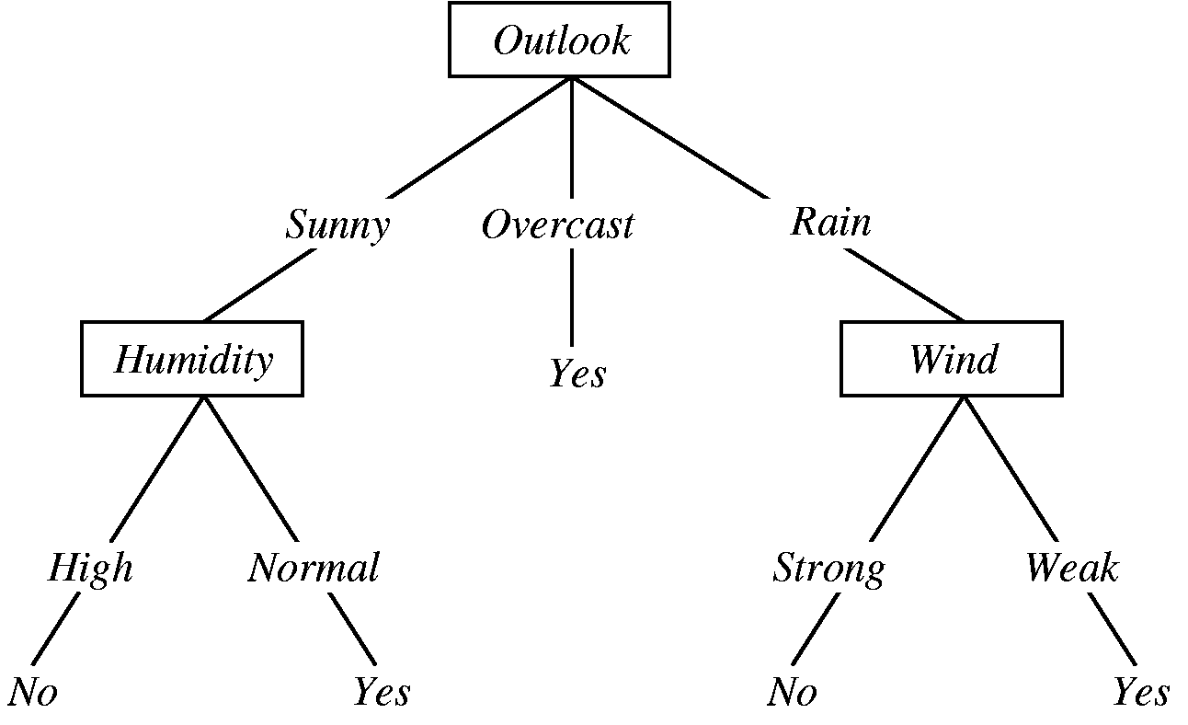
Lesson Objectives
Understand how a decision tree functions and how to build one
Learn to visually represent a decision tree
Understand when to use a decision tree

Slide 4
Agenda
To Play or Not to Play…. Tennis Example of decision trees
Worked example of Iris Decision Trees in Python using Scikit-Learn
When to use decision trees
Intro to Random Forests

Slide 5
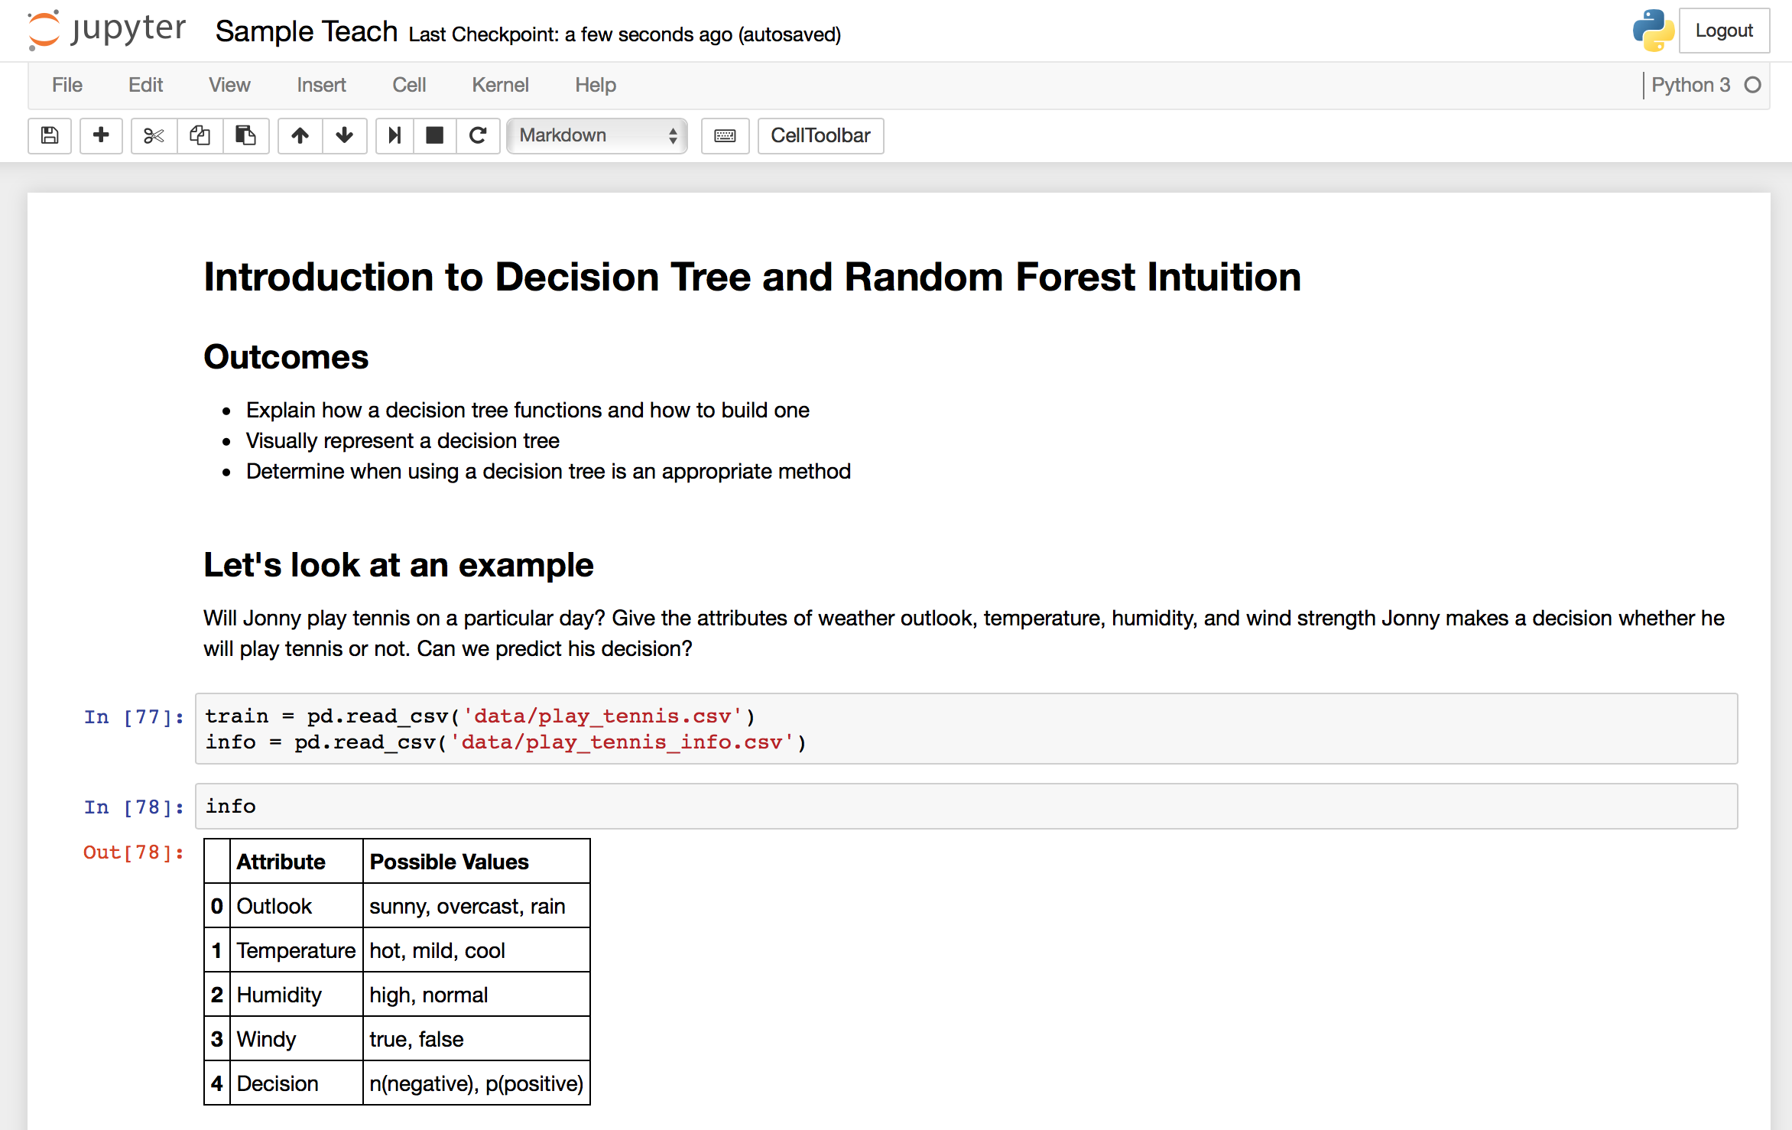
Jupyter Notebook

Slide 6
The End
By Andrew Szwec

Slide 10
Split data on column labels then calculate number of outcomes
https://youtu.be/eKD5gxPPeY0

Slide 11
Decision Trees for Classification
Decision trees for classification - classes like dog/cat, will purchase/won’t purchase
Decision trees for regression - predicts a value like house price
Make a decision tree for taxi dataset
Visualise it
Now use a toy dataset so they can do it themselves
Prune tree using validation set. Take away each node separately and see how performance improve/degrades against the validation set

Slide 12
Decision Tree
Is Outlook Overcast?
False
True
Is Humidity is Normal?
Play tennis
False
True
Does not Play
Play Tennis

